Slide 1
Topic Model Advancements
What has been done and should be done

Slide 2
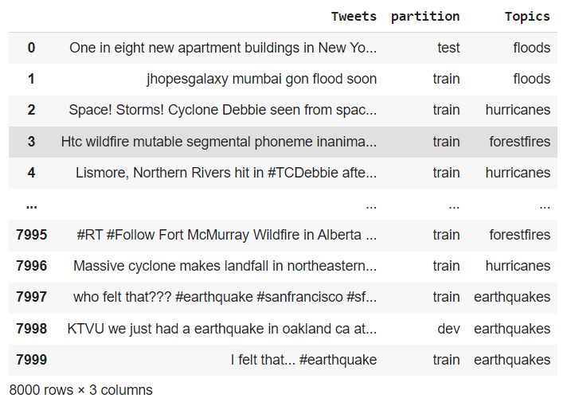
Tweets preprocessing
Use Crisis_12 as an example:
Original:

Slide 3
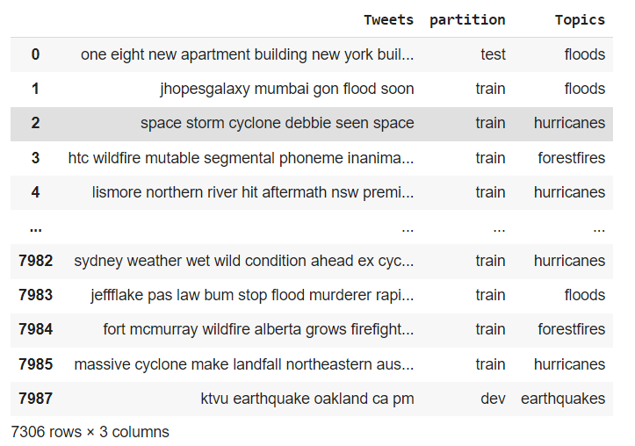
Tweets preprocessing
Preprocessed:
(Including lower case, remove urls, stop words, lemmatization, remove short sentences etc.)

Slide 4
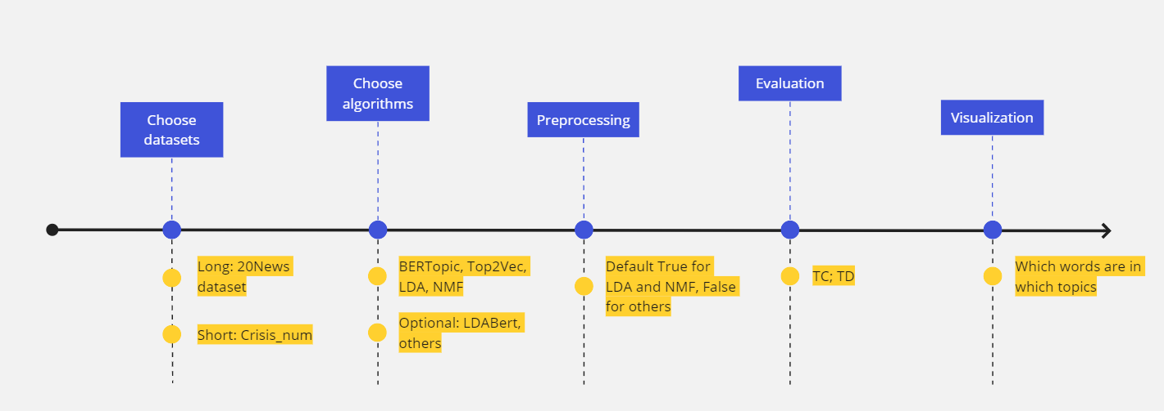
Code integration plan

Slide 5
Research as a Team
LDA and NMF: Link
BERTopic: Link
Top2Vec: Link

Slide 6
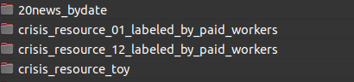
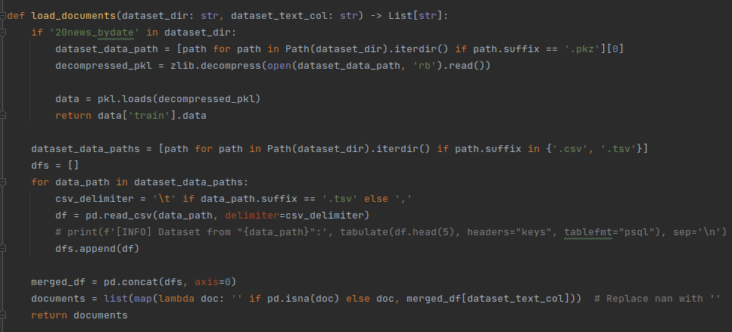
Datasets and Generic Dataset Loader
Will be added: Yahoo Dataset and other CRISIS short text datasets

Slide 7
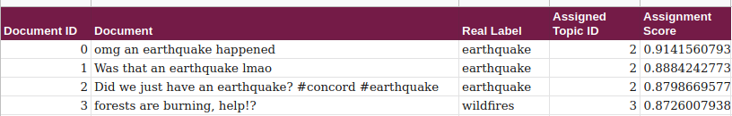
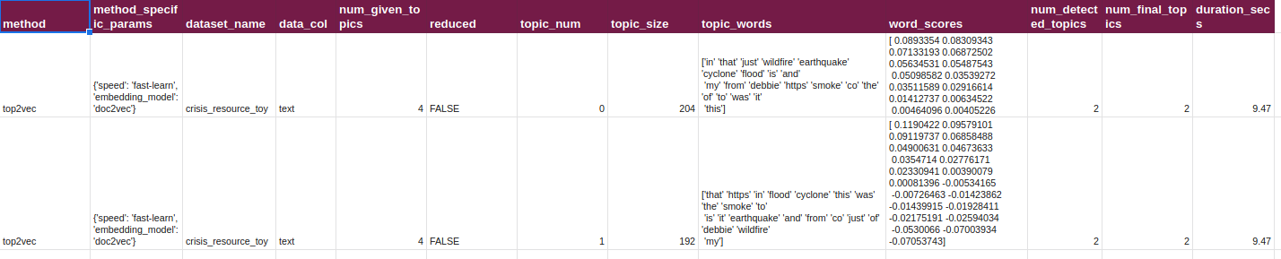
Model Output Design
Doc-Topic Table:
Topic-Word Table:
Will be added: More method specific parameters

Slide 8
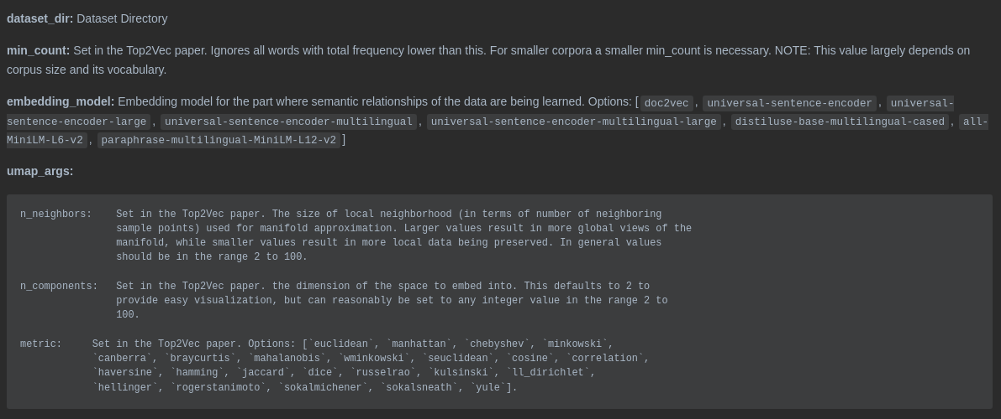
Top2Vec - Extracted Tunable Parameters Pt.1

Slide 9
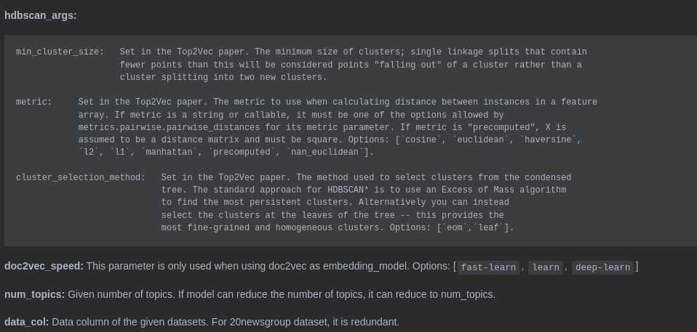
Top2Vec - Extracted Tunable Parameters Pt.2

Slide 10
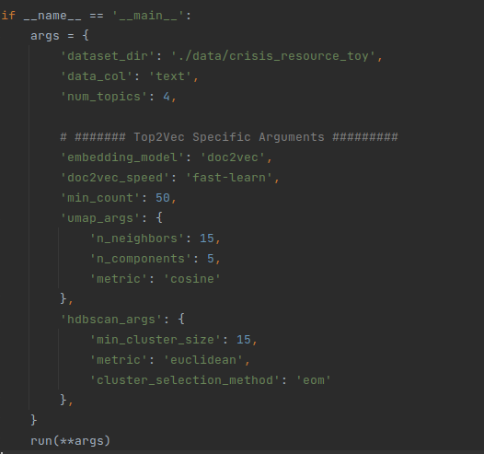
Top2Vec - Extracted Tunable Parameters Application

Slide 11
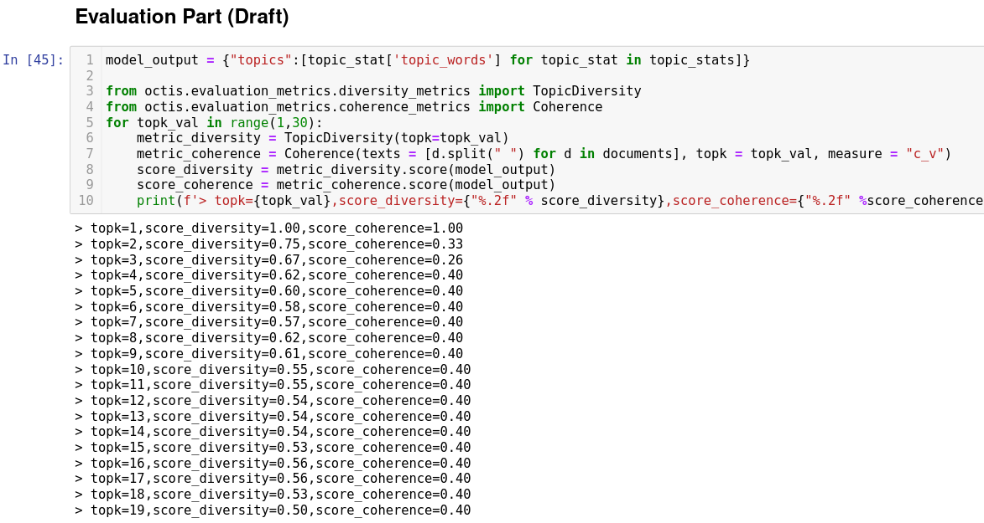
Top2Vec - What Comes Next - Evaluation
Note: It is planned in the Generic Evaluation Module Design

Slide 12
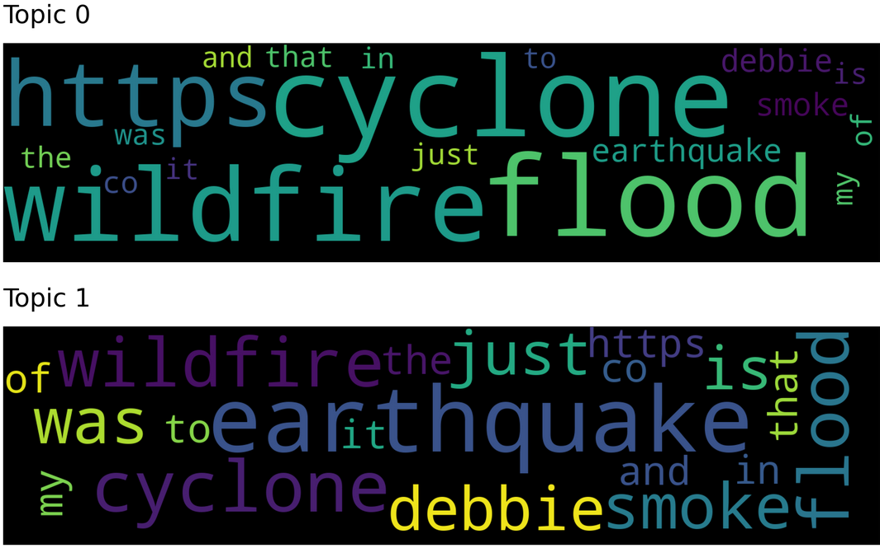
Top2Vec - What Comes Next - Visualization Module
Note: It is planned in the Generic Visualization Module Design

Slide 13
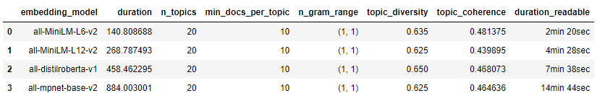
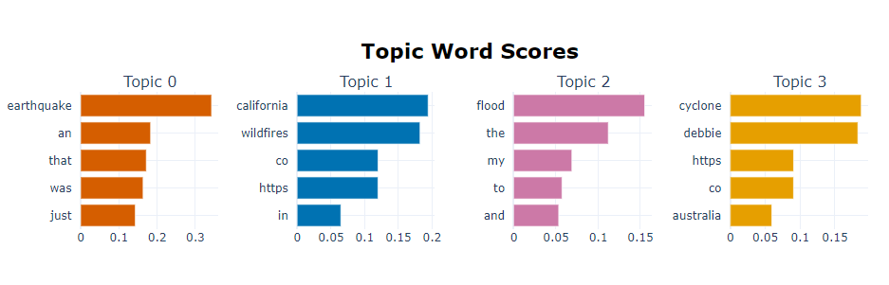
BERTopic - A short glimpse
Comparison for BERTopic on Crisis #12:
Example Topics for Crisis #12:

Slide 14
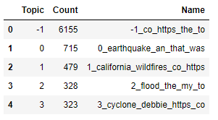
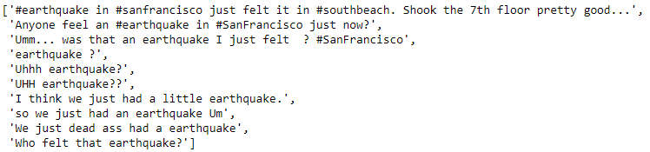
BERTopic - A short glimpse 2
Problem: with only a few topics a lot of the tweets are classified as noise
Example docs for topic 0:

Slide 15
Topic Model Evaluation Research
Topic coherence measures: “best” measure in the sense of correlation with human judgement -> C_v: big sliding window, word with whole window, indirect NPMI and mean (see: “Exploring the Space of Topic Coherence Measures”)
Top2vec: compares different algs with Topic Information Gain and fixed #topics in stepsizes
BERTopic: compares algs with Topic coherence (NPMI) and Topic diversity (% of unique words)
NEED not only metric evaluation but human judgment (with visualization) as well

Slide 16
Our Questions on Clickup

